Slide 1
Skills Bootcamp Classroom Rules
Be on time: Just like in a physical classroom, it's important to be punctual for your online class. Log in to the virtual classroom a few minutes before the class starts.
Turn Cameras on: In order to maximise your learning studies show that being able to see your peers and your tutor being able to see you can increase motivations and retention, therefore we ask to keep your cameras on.
Attend all classes: In order to be successful in your bootcamp studies you need to attend all live sessions, therefore you should prioritise and make time for these sessions.
Avoid distractions: Turn off your phone notifications, close any other unnecessary tabs, and focus solely on the class.
Participate actively: It's important to be an active participant in the class. Ask questions, answer questions, and participate in discussions.
Use proper language and tone: Use respectful language and tone when communicating with your classmates and instructor. Avoid using slang or inappropriate language.
Respect others' opinions: Be respectful of others' opinions, even if they differ from your own. Avoid making negative comments or attacking others.
Follow the instructor's guidelines: Follow the instructor's guidelines, such as submitting assignments on time.
Be polite: Be polite and respectful to everyone in the class, including the instructor, classmates, and guest speakers.
Dress appropriately: Even though you are not in a physical classroom, it's important to dress appropriately. Dress as if you were going to a face-to-face class.
Use appropriate technology: Ensure that you have the necessary equipment, such as a reliable internet connection, a microphone, and a webcam, and that they are in good working condition.

Slide 2
Software Developer Bootcamp
Unit 3 – Coding and Architecture
Week 7C

Slide 3
Objectives
Following this session, you should be able to:
Understand the Basics of Different Types of Software Testing
Identify Key Processes Involved in Unit and Integration Testing
Analyse Processes in Advanced Testing Methods
Understand and solve nested selection challenges.

Slide 4
Nested selection: walkthrough
State .
1 2 3 4 5 6 7 8 9 10 | print("Username: ") username = input() if username == "Eirini": print("Password: ") password = input() if password == "Fish4321": print("Access granted") print("...program closing")
username
password
Input/output .
Username:

Slide 5
Nested selection: walkthrough
State .
1 2 3 4 5 6 7 8 9 10 | print("Username: ") username = input() if username == "Eirini": print("Password: ") password = input() if password == "Fish4321": print("Access granted") print("...program closing")
username
Eirini
password
Input/output .
Username:
Eirini

Slide 6
Nested selection: walkthrough
State .
1 2 3 4 5 6 7 8 9 10 | print("Username: ") username = input() if username == "Eirini": print("Password: ") password = input() if password == "Fish4321": print("Access granted") print("...program closing")
username
Eirini
password
True
Input/output .
Username:
Eirini

Slide 7
Nested selection: walkthrough
State .
1 2 3 4 5 6 7 8 9 10 | print("Username: ") username = input() if username == "Eirini": print("Password: ") password = input() if password == "Fish4321": print("Access granted") print("...program closing")
username
Eirini
password
Input/output .
Username:
Eirini
Password:

Slide 8
Nested selection: walkthrough
State .
1 2 3 4 5 6 7 8 9 10 | print("Username: ") username = input() if username == "Eirini": print("Password: ") password = input() if password == "Fish4321": print("Access granted") print("...program closing")
username
Eirini
password
Fish4321
Input/output .
Username:
Eirini
Password:
Fish4321

Slide 9
Nested selection: walkthrough
State .
1 2 3 4 5 6 7 8 9 10 | print("Username: ") username = input() if username == "Eirini": print("Password: ") password = input() if password == "Fish4321": print("Access granted") print("...program closing")
username
Eirini
password
Fish4321
Input/output .
Username:
Eirini
Password:
Fish4321
True

Slide 10
Nested selection: walkthrough
State .
1 2 3 4 5 6 7 8 9 10 | print("Username: ") username = input() if username == "Eirini": print("Password: ") password = input() if password == "Fish4321": print("Access granted") print("...program closing")
username
Eirini
password
Fish4321
Input/output .
Username:
Eirini
Password:
Fish4321
Access granted

Slide 11
Nested selection: walkthrough
State .
1 2 3 4 5 6 7 8 9 10 | print("Username: ") username = input() if username == "Eirini": print("Password: ") password = input() if password == "Fish4321": print("Access granted") print("...program closing")
username
Eirini
password
Fish4321
Input/output .
Username:
Eirini
Password:
Fish4321
Access granted
...program closing
>>>

Slide 12
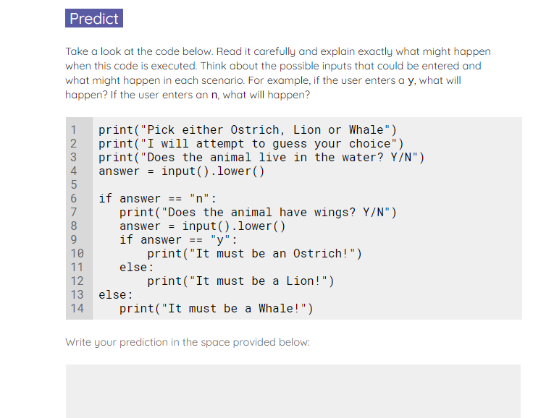
Guess the animal game
Use the worksheet to investigate and modify the ‘guess the animal’ game.
The activity will allow you to explore nested selection further.
Notes:
A2 Worksheet – Guess the animal game (20 minutes activity)

Slide 13
Nested selection
print("What is your age?")
age = int(input()) #q1
if age > 10:
print("Total books read in 2019:")
books = int(input()) #q2
if books > 10:
print("That's impressive!")
else:
print("You should read more")
else:
print("I hope you like reading")
Question .
Assuming that 12 is entered for the first question and 3 is entered for the second. What will be the output?
I hope you like reading
You should read more
That’s impressive!
There is an error on line 2 so it will not execute
1
▹
2
3
4

Slide 14
Nested selection
print("What is your age?")
age = int(input()) #q1
if age > 10:
print("Total books read in 2019:")
books = int(input()) #q2
if books > 10:
print("That's impressive!")
else:
print("You should read more")
else:
print("I hope you like reading")
Question .
Assuming that 10 is entered for the first question and 10 is entered for the second. What will be the output?
I hope you like reading
You should read more
That’s impressive!
The program will never reach question 2
1
2
3
▹
4

Slide 15
Basics of Different Types of Software Testing

Slide 16

What is Software Testing?
Definition of Software Testing: Software testing evaluates a software application to identify any errors, gaps, or missing requirements in contrast to the actual requirements.
Purpose of Software Testing: Software testing aims to ensure a software application's quality, reliability, and performance while identifying any defects or vulnerabilities.
Types of Software Testing: There are various types of software testing, including but not limited to, unit testing, integration testing, functional testing, and security testing, each serving a specific purpose in the software development lifecycle.

Slide 17

Unit Testing
Definition of Unit Testing: Unit testing is verifying individual components or units of software to ensure they work as intended.
Purpose of Unit Testing: The primary purpose of unit testing is to validate that each unit of the software performs as designed, thereby catching issues early in the development cycle.
Benefits of Unit Testing: Unit testing offers numerous benefits, such as improving code quality, facilitating easier debugging, and providing a solid foundation for future code changes.

Slide 18

Integration Testing
Definition of Integration Testing: Integration testing is testing the interaction between multiple components or units of a software application to ensure they work together as expected.
Purpose of Integration Testing: Integration testing aims to validate that different modules or components of a software system interact seamlessly, thereby ensuring the system's overall functionality and reliability.
Benefits of Integration Testing: Integration testing offers the advantage of early detection of issues related to data communication, data storage, and component interaction, thereby reducing the time and cost of debugging in later stages of development.

Slide 19

System Testing
Definition of System Testing: System testing is the phase in software testing where the entire application is evaluated to verify that it meets specified requirements.
Purpose of System Testing: The primary purpose of system testing is to validate the software's end-to-end functionality and ensure it meets the defined system requirements.
Benefits of System Testing: System testing offers the benefit of identifying issues related to data integrity, performance, and security, thereby ensuring a reliable and robust software application.

Slide 20

Acceptance Testing
Definition of Acceptance Testing: Acceptance testing is the phase in software testing where a system is tested for acceptability to ensure that it meets the specified criteria and is ready for use by the end user.
Purpose of Acceptance Testing: The primary purpose of acceptance testing is to validate that a software system fulfils the business requirements, ensuring that it meets functional and non-functional criteria for acceptance.
Benefits of Acceptance Testing: Acceptance testing confirms that a software system is complete and fully functional, thereby reducing the risk of post-release defects and increasing customer satisfaction.

Slide 21

Usability Testing
Definition of Usability Testing: Usability testing is evaluating a product or system by testing it with representative users to identify any usability issues and gather data on participants' performance and satisfaction levels.
Purpose of Usability Testing: The primary purpose of usability testing is to understand how real users interact with a product and to improve the product based on the test results to make it more user-friendly.
Benefits of Usability Testing: Usability testing offers invaluable insights into user behavior, helps identify areas for improvement, and ultimately leads to a more efficient and satisfying user experience.

Slide 22

Security Testing
Definition of Security Testing: Security testing is the practice of evaluating a software system to identify vulnerabilities, risks, and threats that could compromise its integrity, confidentiality, or availability.
Purpose of Security Testing: The primary purpose of security testing is to uncover weaknesses in a software system that could be exploited, ensuring that adequate measures are in place to protect against potential attacks.
Benefits of Security Testing: Security testing includes enhanced data protection, compliance with regulatory standards, and increased customer trust due to a more secure software environment.

Slide 23

Conclusion
Importance of software testing
Benefits of software testing
Conclusion

Slide 24
Key Processes Involved in Unit and Integration Testing

Slide 25
What is Unit Testing?
Unit testing is a software testing method where individual units or components of a software are tested.
It is done to verify that each unit of the software performs as designed.
Unit tests are typically written and run by software developers to ensure that code meets its design and behaves as intended.

Slide 26

What is Integration Testing?
Integration testing is a software testing method where individual units are combined and tested as a group.
It is done to verify the interactions between components and to ensure that the software works as expected when integrated.
Integration tests are typically written and run by software developers to ensure that code meets its design and behaves as intended.

Slide 27

Identifying Key Processes
When it comes to unit and integration testing, there are several key processes that must be identified and followed.
These processes include:
- Identifying the scope of the test
- Writing test cases
- Executing the tests
- Analyzing the results

Slide 28

Identifying the Scope of the Test
The first step in unit and integration testing is to identify the scope of the test.
This involves defining the boundaries of the test, such as which components will be tested and which will not.
It also involves determining the criteria for success and failure of the test.

Slide 29

Writing Test Cases
Once the scope of the test has been identified, the next step is to write test cases.
Test cases are a set of conditions or variables under which a tester will determine whether a system is working correctly.
Test cases should be written in a way that is easy to understand and follow, and should include expected results.

Slide 30

Executing the Tests
Once the test cases have been written, the next step is to execute the tests.
This involves running the tests and recording the results.
It is important to ensure that the tests are run in a controlled environment, and that all results are recorded accurately.

Slide 31

Analysing the Results
Once the tests have been executed, the next step is to analyse the results.
This involves interpreting the data and determining whether the tests were successful or not.
It is important to ensure that the results are interpreted accurately and that any issues are addressed promptly.

Slide 32
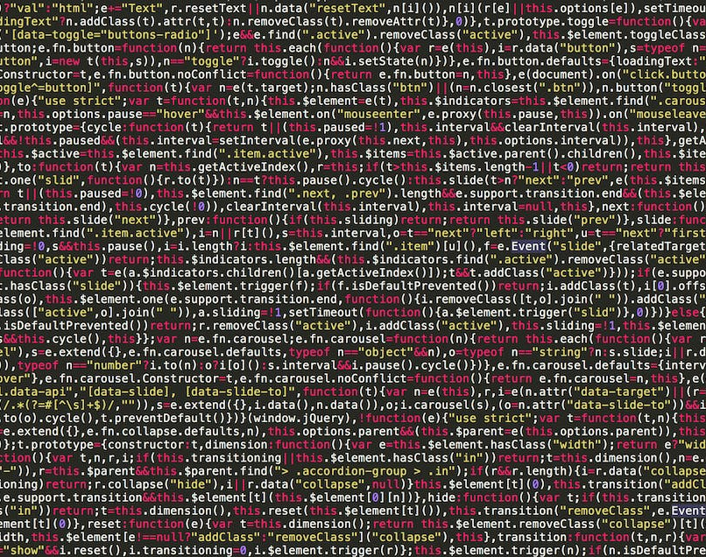
Benefits of Unit and Integration Testing
Unit and integration testing can provide many benefits, including:
- Improved software quality
- Reduced development time and cost
- Increased customer satisfaction
- Improved software reliability

Slide 33

Conclusion
Unit and integration testing are essential processes for ensuring that software is of the highest quality.
By following the key processes outlined in this presentation, developers can ensure that their software meets its design and behaves as intended.
Testing is a powerful tool that can help developers create better software and provide a better experience for their customers.

Slide 34
Processes in Advanced Testing Methods

Slide 35
What is Automated Testing?
Automated testing is the process of using software to execute tests on a system or application.
It is used to compare the expected results of a system or application with the actual results.
It is used to detect bugs and errors in the system or application.

Slide 36

Advantages of Automated Testing
Automated testing is faster than manual testing.
It is more accurate and reliable than manual testing.
It can be used to test a wide range of scenarios.
It can be used to test multiple versions of an application.
It can be used to test multiple platforms and devices.

Slide 37

Disadvantages of Automated Testing
Automated testing can be expensive to set up and maintain.
It can be difficult to set up automated tests for complex applications.
It can be difficult to debug automated tests.
It can be difficult to maintain automated tests over time.

Slide 38
Types of Automated Testing
Unit Testing: Testing individual components of an application.
Integration Testing: Testing how components interact with each other.
Functional Testing: Testing the functionality of an application.
Regression Testing: Testing for bugs after changes have been made.
Performance Testing: Testing the performance of an application.

Slide 39

Tools for Automated Testing
Selenium: A popular open source tool for web application testing.
Appium: An open source tool for mobile application testing.
TestComplete: A commercial tool for automated testing.
Ranorex: A commercial tool for automated testing.
SoapUI: An open source tool for web service testing.

Slide 40

Best Practices for Automated Testing
Create automated tests that are easy to maintain.
Create automated tests that are easy to debug.
Create automated tests that are easy to read.
Create automated tests that are easy to run.
Create automated tests that are easy to understand.

Slide 41

Analyse Processes in Advanced Testing Methods
Advanced testing methods can help to identify bugs and errors more quickly.
Advanced testing methods can help to reduce the time and cost of testing.
Advanced testing methods can help to improve the accuracy and reliability of tests.
Advanced testing methods can help to improve the quality of the software being tested.

Slide 42

Conclusion
Automated testing is a powerful tool for testing software.
It can help to reduce the time and cost of testing.
It can help to improve the accuracy and reliability of tests.
It can help to improve the quality of the software being tested.
Advanced testing methods can help to further improve the testing process.

Slide 43
Objectives
Now, you should be able to:
Understand the Basics of Different Types of Software Testing
Identify Key Processes Involved in Unit and Integration Testing
Analyse Processes in Advanced Testing Methods
Understand and solve nested selection challenges.

Slide 44
Questions?

Slide 45
Thank You

